Slide 1


Slide 2
Thanksgiving
CCLI Song # 7199589
Nick Herbert | Taku Mudere | Zo Chilengwe
© Capitol CMG Genesis; Safe and Sound Music; Remaining portion is unaffiliated
For use solely with the SongSelect® Terms of Use. All rights reserved. www.ccli.com
CCLI Licence No. 33265

Slide 3
1/10
Enter in (Enter in)
His courts with praise (His courts with praise)
For He is greatly (He is greatly)
To be praised (To be praised)

Slide 4
2/10
Enter in (Enter in)
His courts with praise (His courts with praise)
For He is greatly (He is greatly)
To be praised

Slide 5
3/10
What shall we do
We shall lift up a shout
What shall we do
We shall praise Him
What shall we do
For our God made a way
We'll give Him our thanksgiving

Slide 6
4/10
Magnify (Magnify)
His Holy Name (His Holy Name)
For He is greatly (For He is greatly)
To be praised (To be praised)

Slide 7
5/10
Magnify (Magnify)
His Holy Name (His Holy Name)
For He is greatly (For He is greatly)
To be praised

Slide 8
6/10
What shall we do
We shall lift up a shout
What shall we do
We shall praise Him
What shall we do
For our God made a way
We'll give Him our thanksgiving

Slide 9
7/10
Even if the rocks cry out
We're gonna drown them out
With a louder shout of praise
Even when the battles roar
We're gonna praise You Lord
'Cause You are always worthy

Slide 10
8/10
You are worthy
Worthy of honour and praise
You are worthy
We'll sing it again and again

Slide 11
9/10
What shall we do
We shall lift up a shout
What shall we do
We shall praise Him
What shall we do
For our God made a way
We'll give Him our thanksgiving

Slide 12
10/10
We'll give Him our thanksgiving
We'll give Him our thanksgiving

Slide 13
Praise
CCLI Song # 7213077
© Brandon Lake MusicFor Humans PublishingMaverick City PublishingCapitol CMG GenesisCapitol CMG ParagonHousefires SoundsWriter's Roof PublishingMusic by Elevation Worship Publishing
For use solely with the SongSelect® Terms of Use. All rights reserved. www.ccli.com
Note: Reproduction of this sheet music requires a CCLI Music Reproduction Licence. Please report all copies.
CCLI Licence No. 33265

Slide 14
1/12
Let everything that has breath
Praise the Lord
Praise the Lord

Slide 15
2/12
I’ll praise in the valley
Praise on the mountain
I’ll praise when I’m sure
Praise when I’m doubting

Slide 16
3/12
I’ll praise when outnumbered
Praise when surrounded
'Cause praise is the water
My enemies drown in

Slide 17
4/12
As long as I’m breathing
I’ve got a reason to Praise the Lord oh my soul
Praise the Lord oh my soul

Slide 18
5/12
I’ll praise when I feel it
And I’ll praise when I don’t
I’ll praise 'cause I know
You’re still in control

Slide 19
6/12
'Cause my praise is a weapon
It’s more than a sound
My praise is the shout
That brings Jericho down

Slide 20
7/12
As long as I’m breathing
I’ve got a reason to Praise the Lord oh my soul
Praise the Lord oh my soul

Slide 21
8/12
I won’t be quiet
My God is alive
How could I keep it inside
Praise the Lord oh my soul

Slide 22
9/12
I’ll praise 'cause You’re sovereign
Praise 'cause You reign
Praise 'cause You rose and defeated the grave
I’ll praise 'cause You’re faithful
Praise 'cause You’re true
Praise 'cause there’s nobody greater than You

Slide 23
10/12
Praise the Lord oh my soul
Praise the Lord oh my soul
Praise the Lord oh my soul
Praise the Lord oh my soul
I won’t be quiet
My God is alive
How could I keep it inside

Slide 24
1 1/12
I won’t be quiet
My God is alive
How could I keep it inside
I won’t be quiet
My God is alive
How could I keep it inside
Praise the Lord oh my soul

Slide 25
12/12
Let everything that has breath
Praise the Lord
Praise the Lord

Slide 27
Gratitude
CCLI Song # 7158417
Benjamin Hastings | Brandon Lake | Dante Bowe
© 2019 SHOUT! Music Publishing Australia; Bethel Music Publishing; Bethel Worship Publishing; Brandon Lake Music; Maverick City Publishing; Maverick City Publishing Worldwide
For use solely with the SongSelect® Terms of Use. All rights reserved. www.ccli.com
CCLI Licence No. 33265

Slide 28
1/7
All my words fall short
I got nothing new
How could I express
All my gratitude

Slide 29
2/7
I could sing these songs
As I often do
But every song must end
And You never do

Slide 30
3/7
So I throw up my hands
And praise You again and again
‘Cause all that I have is a hallelujah hallelujah
And I know it’s not much
But I’ve nothing else fit for a king
Except for a heart singing hallelujah
Hallelujah

Slide 31
4/7
I’ve got one response
I’ve got just one move
With my arms stretched wide
I will worship You

Slide 32
5/7
So I throw up my hands
And praise You again and again
‘Cause all that I have is a hallelujah hallelujah
And I know it’s not much
But I’ve nothing else fit for a king
Except for a heart singing hallelujah
Hallelujah

Slide 33
6/7
Come on my soul
Oh don’t you get shy on me
Lift up your song
‘Cause you’ve got a lion inside of those lungs
Get up and praise the Lord (REPEAT)

Slide 34
7/7
So I throw up my hands
And praise You again and again
‘Cause all that I have is a hallelujah hallelujah
And I know it’s not much
But I’ve nothing else fit for a king
Except for a heart singing hallelujah
Hallelujah

Slide 35
Bless God
CCLI Song # 7206380
Brandon Lake | Brooke Ligertwood | Cody Carnes
© 2023 Brandon Lake Music; Brooke Ligertwood Designee; Capitol CMG Paragon; Writer's Roof Publishing
For use solely with the SongSelect® Terms of Use. All rights reserved. www.ccli.com

Slide 36
1/11
Blessed are those who run to Him
Who place their hope and confidence in Jesus
He won’t forsake them
Blessed are those who seek His face
Who bend their knee and fix their gaze on Jesus
They won’t be shaken

Slide 37
2/11
Come on and praise the Lord with me
Sing if you love His name
Come on and lift your voice with me
He’s worthy of all our praise

Slide 38
3/11
Blessed are those who walk with Him
Whose hearts are set on pilgrimage with Jesus
They’ll see His glory
Blessed are those who die to live
Whose joy it is to give it all for Jesus
And for Him only
Oh Jesus all for Your glory

Slide 39
4/11
Come on and praise the Lord with me
Sing if you love His name
Come on and lift your voice with me
He’s worthy of all our praise

Slide 40
5/11
Come on and bring your offering
Sing if you’ve known His grace
Come on and lift up your holy hands
He’s worthy of all our praise

Slide 41
6/11
Bless God in the sanctuary
Bless God in the fields of plenty
Bless God in the darkest valley
Every chance I get I bless Your name

Slide 42
7/11
Bless God when my hands are empty
Bless God with a praise that costs me
Bless God when nobody’s watching
Every chance I get I bless Your name

Slide 43
8/11
Bless God when the weapon’s forming
Bless God when the walls are falling
Bless God ‘cause He goes before me
Every chance I get I bless Your name

Slide 44
9/11
Bless God for He holds the vict’ry
Bless God for He’s always with me
Bless God for He’s always worthy
Every chance I get I bless Your name (REPEAT)
Every chance I get

Slide 45
10/11
Come on and praise the Lord with me
Sing if you love His name
Come on and lift your voice with me
He’s worthy of all our praise

Slide 46
11/11
Come on and bring your offering
Sing if you’ve known His grace
Come on and lift up your holy hands
He’s worthy of all our praise He’s worthy of all our praise
He’s worthy of all our praise

Slide 48


Slide 49
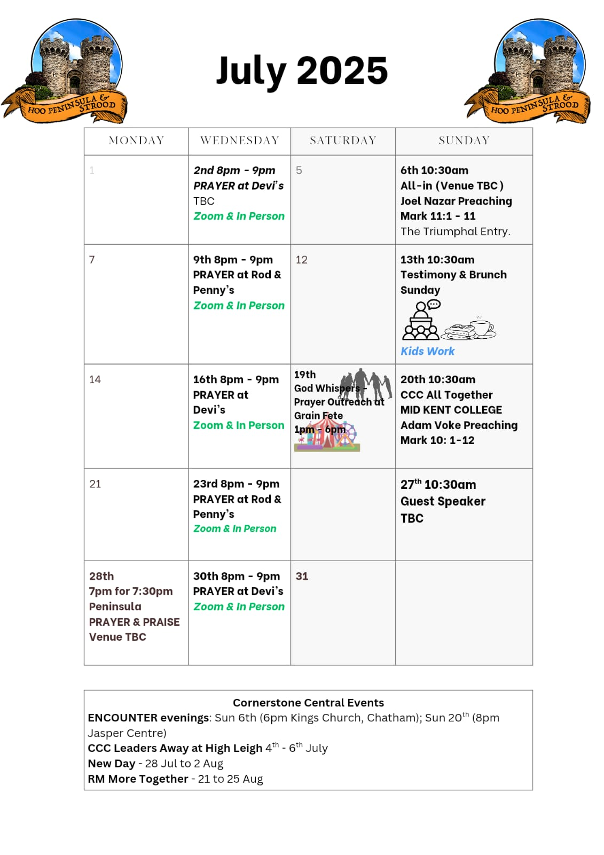

Slide 50


PPP God Whispers

Slide 51


Slide 52

Grow Group 1
On YOUR MARK!

Slide 53
Leaders
Leaderss
Phil & Kim
Maria (Mia) Warren
Matthew Harrison
Richard & Elisha Acheampong
Phil & Kim
Maria (Mia) Warren
Matthew Harrison
Richard & Elisa Acheampong

Slide 54

Storm Walker
Storm Walker
Symbolising, trust in Jesus Christ through life's storms.
Mark 4:35-41

Slide 55



Group Leaders
Micheal and Mwamba
Wilfred and Parveen
Hannah

Slide 56


Slide 57


Slide 58


Slide 59
2 Corinthians 14 May the grace of the Lord Jesus Christ, and the love of God, and the fellowship of the Holy Spirit be with you all
Surely goodness and mercy shall follow us all the days of our lives, and we shall dwell in the house of the Lord forever.

